Slide 1
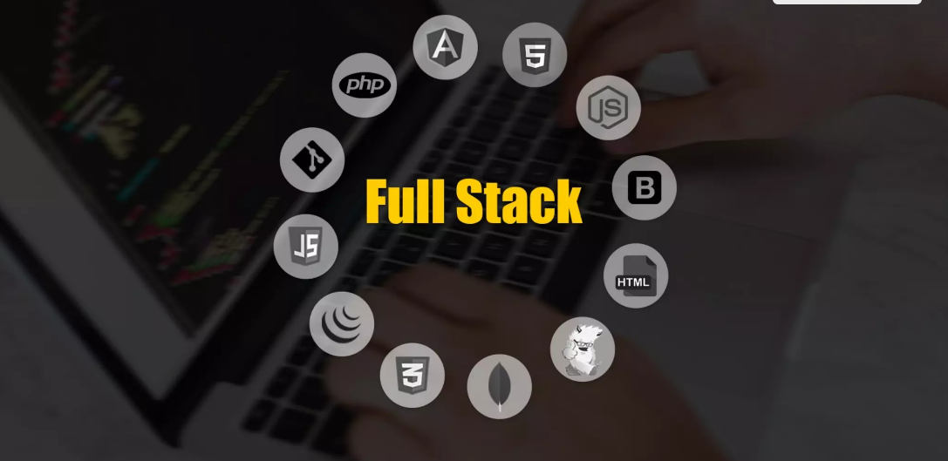
Nishil Patel

Slide 2
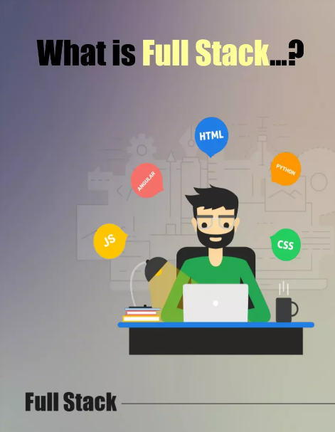
Full Stack developer:
A combination of front & backend.
Someone who is familiar with
layers of software development.
They are expert in functional knowledge of product.

Slide 3
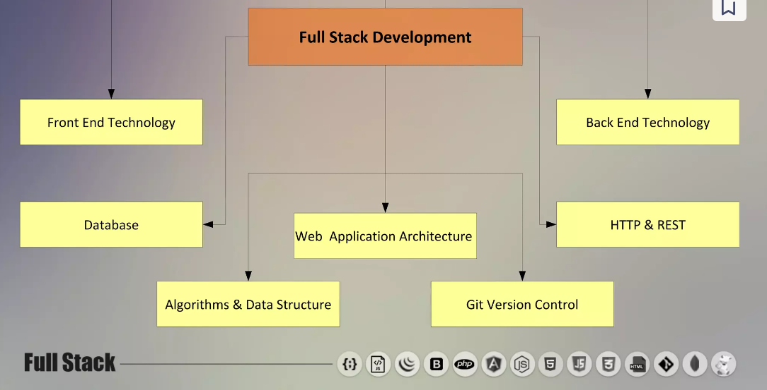

Slide 4
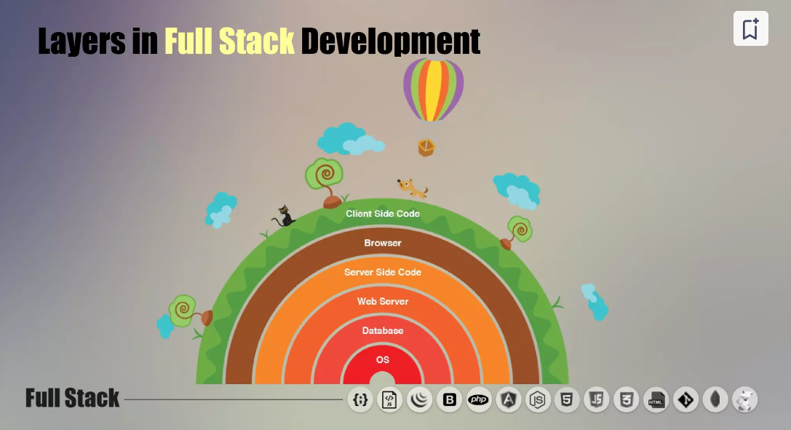

Slide 5
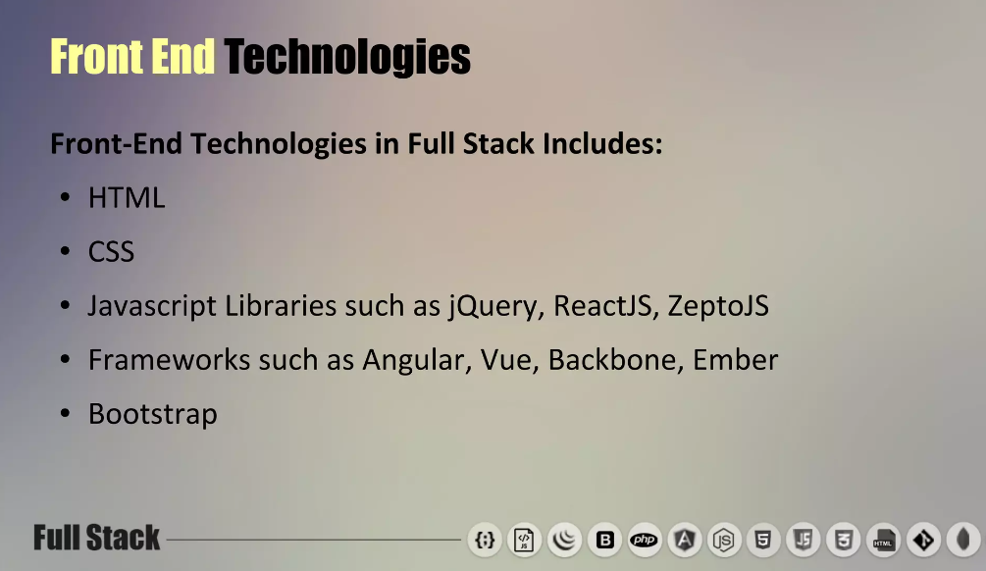

Slide 6
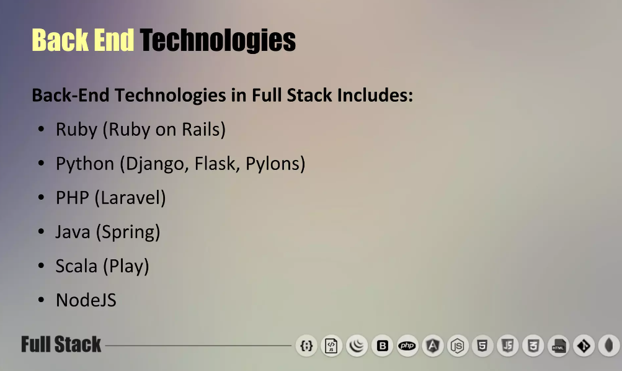

Slide 7
Thank You

